Slide 1
Power BI Final Project
COVID-19 Data Analysis
Presented by: Keith Billman
Date: February 18, 2025
Notes:
Hello everyone today I will be presenting my final project for the Power BI module. The topic of my analysis is COVID-19 Data Analysis.

Slide 2
Contents
Project Overview
Data Import, Cleaning and Modeling
Method/Approach: KPIs, Total Cases, Deaths, Vax, Test Analysis
Further Data Overview – Moving Avg. Cases, World Map, Trends, Vax Impact
Key Findings & Recommendations
Conclusion & Q&A
Notes:
Over the next few minutes, I will walk you through the project overview, data import, cleaning and modeling, my method/approach, data analysis, Regional Comparisons and key findings from my Power BI report. Of
Course, to conclude we will have a short Q & A.

Slide 3
Project Overview
• Objective: Analyze COVID-19 Data to Support Informed Decision-making.
• Data: Global COVID-19 Cases, Deaths, and Vaccination and Test Statistics.
• Tools: Microsoft Power BI for Data Cleaning, Analysis, and Visualization.
Notes:
The primary objective of this project was to analyze COVID-19 data to support data-driven decision-making."
The dataset included global case numbers, deaths, and vaccination statistics."
Microsoft Power BI was used to clean, analyze, and visualize the data."
This project aims to provide insights into case trends, mortality rates, vaccination effectiveness, and regional disparities."
Key questions explored include:
How have case numbers evolved over time?
Which countries were the most affected?
How effective have vaccinations been in controlling the spread?

Slide 4
Data Import & Cleaning
• Data Loaded from CSV into Power BI.
• Checked for Missing/Incorrect Values.
• Cleaned and Transformed Data for Better Accuracy.
Notes:
The data was sourced from an open COVID-19 dataset containing daily updates from multiple countries.
Initial cleaning involved handling missing values in key fields and Transformation steps included standardizing date formats, removing anomalies, and ensuring consistency across regions.
The Data was then structured to be analyzed in an efficient manner.

Slide 5
Data Modeling
• Created Country and Date Dimension Tables.
• Established Relationships for Better Insights.
• Used DAX Measures for Calculations.
Notes:
To enhance analytical capabilities, dimension tables were created including a country dimension table and a date dimension table as required by the Project.
I also added a few more, some which were perhaps not necessary for the project.
Relationships were established between tables to enable comparisons across different variables.
DAX measures were created for certain calculations including totals, maxes, averages and percentage changes over time.

Slide 6
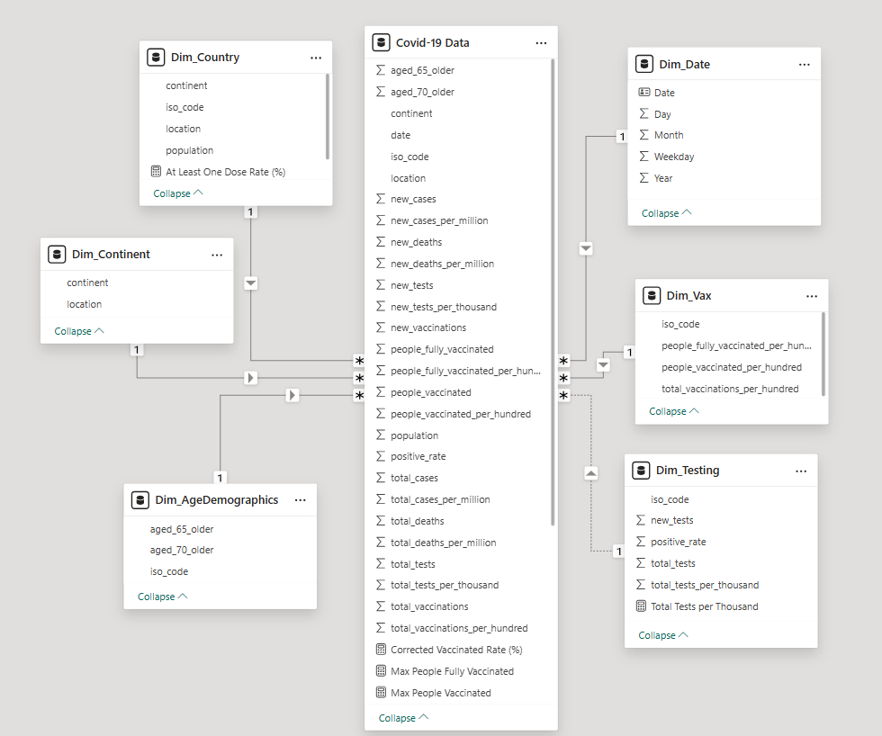
Modeling
Notes:
The model helped with slicing and filtering based on regions, time periods, etc. You can have a quick glance at my finished model.
And yes, I am aware the Brits spell Modeling with 2 “L”s but they are wrong.

Slide 7

KPI Cards
Method/Approach: Key Statistics / Worksheet
Notes:
Now turning to the approach I took towards analyzing the data. To begin I created a worksheet to collect some of the main statistics I thought I would be useful. During this step,
I spent a lot of time checking and double-checking the numbers with various sources . Keep in mind, this page is not a finished product, but more like A bit like a piece of scratch paper
or „Kratzpapier“ in German.

Slide 8
Cases Dashboard
Notes:
The next step was to go a little deeper into the data. To do this I created separate dashboards for our 4 main topics: Cases, Deaths, Vaccinations and Tests. The dashboards all followed the same basic pattern:
Total Numbers, Numbers per year, Totals by Continent, Top 10 by country, Top 10 Totals per million. I added continent, country and a time slicer to dig more deeply into the data and so the dashboard could be interactive. For example,
we are not limited to only seeing the top 10 by country but can select any country and any time frame.

Slide 9
COVID-19 Case Trends
• Analysis of case growth over time.
• Identified peak periods and trends.
• Interactive filters to explore different time frames.
Notes:
With the first dashboard I could track the progression of COVID-19 cases globally, seeing spikes during major outbreaks.
The analysis reveals trends such as the impact of vaccinations.
And again, the Slicers helped help to explore case growth in different regions and time periods. Remember one of our Key questions included
How have case numbers evolved over time? Our dashboard helped us to answer that question.

Slide 10
Deaths Dashboard
Notes:
My next dashboard was for deaths. Same format as the first for cases: Total, total by year, continent, Top 10 by country and Total per Millions by country. Again, interactive to allow us more focus
on a particular area or time frame. Here we were able to answer our second key question:
Which countries were the most affected?

Slide 11
Deaths Analysis
• Compared Mortality Rates across Countries.
• Identified Regions with Highest Fatality Impact.
• Insights on Pandemic Severity.
Notes:
The deaths analysis focuses on total deaths and new deaths across different regions.
Mortality rate per million people was used to normalize the data and compare across countries.
Top 10 lists identify the most affected countries in terms of death toll.
As you would expect, regions with strong healthcare systems had lower mortality rates.

Slide 12
Map of Total Cases and Deaths
Notes:
It was at this point I decided I wanted a different type of visual and I generated a global heat map of our first 2 subjects Cases and Deaths.
Here I have a continent slicer mislabeled as country but still this and the time bar allows us to identify hotspots and compare regional differences.

Slide 13
Total Vaccinations
Notes:
Returning to our main topics, we have our Vaccinations Dashboard. Similar setup to the others…our numbers, etc. This analysis helped us to answer our third Key question :
How effective have vaccinations been in controlling the spread?

Slide 14
Vaccination Progress
• Trends in vaccination rollout.
• Effectiveness of vaccinations in controlling spread.
• Identified countries with highest/lowest vaccination rates.
Notes:
With the vaccination dashboard we looked for trends in rollout and to determine their effectiveness in controlling the virus.
We can see how quickly different countries administered vaccines to their populations.
A comparison between fully vaccinated individuals and total vaccinations highlights discrepancies in vaccine distribution.
Findings suggest that countries with early vaccination campaigns saw a faster decline in case numbers.

Slide 15
Total Tests
Notes:
And last but not least, we come to testing. One note here, The total tests number is 2 Trillion in English, but Billionen auf Deutsch. I have my Power BI set to English, but my Service function is
still in German and somehow this got translated. I don‘t think we need to spend a lot of time here.

Slide 16
Testing Analysis
Key Insights:
Testing Played a Crucial Role in Controlling the Spread of the Virus
Higher Testing Rates and Detection Efficiency led
to Quicker Responses.
Impact of Testing Availability on Pandemic Containment Efforts.
Notes:
Testing played a crucial role in controlling the spread of the virus.
My analysis focused on total tests conducted and Countries with higher testing rates were able to detect outbreaks earlier, leading to quicker responses."
The relationship between testing volume and case detection was examined, highlighting the importance of widespread testing efforts.“
Understanding the role of large-scale testing in controlling outbreaks.

Slide 17
New Cases and Moving Average Cases
Notes:
To round out my analysis, I created a few more charts……. Such as New Cases & Moving Average Cases: Identifies daily new case trends while smoothing fluctuations to highlight real patterns.
One of the key aspects of analyzing the COVID-19 pandemic is understanding how new cases evolved over time. By using moving averages, we can filter out daily fluctuations and see the broader trend of infections.
This is crucial for identifying peaks and the effectiveness of containment efforts.

Slide 18
Trends
Notes:
I also compared trends. Tthe trends analysis page aggregates yearly data on cases, vaccinations, and deaths. This long-term view allows us to assess how different phases of the pandemic evolved and how interventions,
such as vaccination rollouts, influenced outcomes. The goal is to observe shifts in pandemic response and measure the effectiveness of containment strategies over time.

Slide 19
Comparisons
Notes:
I also compared different values…..

Slide 20
Vaccination Impact
Notes:
….and looked at other data. These pages were relatively easy to create as it was mostly cut and paste from my existing dashboards.

Slide 21
Key Findings & Recommendations
• Testing and Vaccinations Reduced Case Numbers and Death Rates
• Countries with Better Healthcare Systems had Lower Death Rates.
• General Recommendation: Use Data-driven Strategies for Better Pandemic Response.
Specific Policy Recommendations: Rapid Vax Rollouts, Improving Healthcare Resources, Ensuring Early Intervention
Notes:
Key insights from the analysis (which are probably not surprising) include: Vaccination campaigns reduced case numbers and death rates over time.
Countries with better healthcare infrastructure had lower fatality rates.
Recommendations include utilizing Data-driven strategies for a Better response and more specifically,
focusing on rapid vaccination rollouts, improving healthcare resources, and ensuring early intervention measures in future pandemics.

Slide 22
Summary & Q&A
In Summary, This Analysis Provides Data-driven Insights into the COVID-19 Pandemic.
It Highlights Important Trends and Regional Differences in Case Numbers, Mortality rates, and Vaccinations.
This Data can be used to Shape Future Health Policies and Improve Pandemic Responses.
Thank You for Your Time.
Open for Questions and Discussions.
Notes:
In summary, this analysis provides data-driven insights into the COVID-19 pandemic.
It highlights important trends and regional differences in case numbers, mortality rates, and vaccinations.
This data can be used to shape future health policies and improve pandemic responses.
I appreciate your time, and I am happy to answer any questions you may have.

